Slide 1
Electrochemical-calorimetric studies on
lithium ion pouch cells
E. Schuster, C. Ziebert, H. J. Seifert
Karlsruhe Institute of Technology (KIT)
Notes:
- Good morning ladies and gentlemen
- In my presentation I will show my work on safety aspects of lithium ion batteries
- This I carry out with electrochemical-calorimetric studies klick

Slide 2
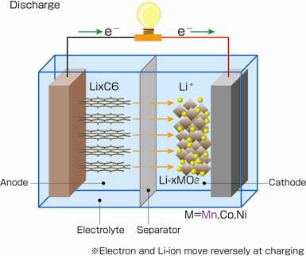
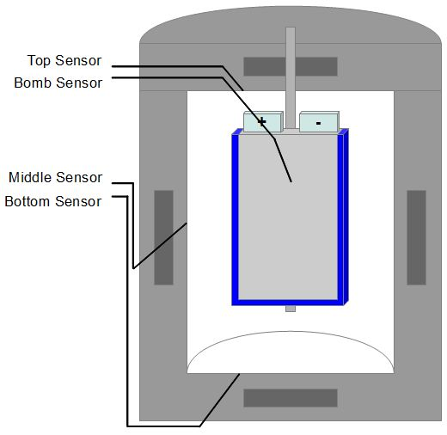
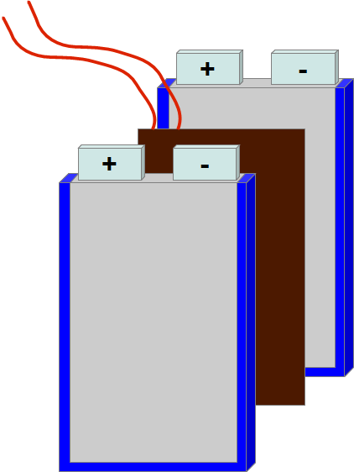
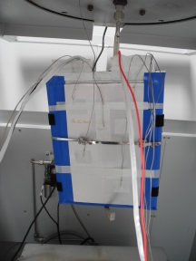
Outline
Short Motivation
Experimental setup, battery and calorimeter
Theoretical overview of heat generation
Parameter measurements
Isoperibolic measurements
Adiabatic measurements
Conclusion
30.10.2013 E2C 2013 - 3rd European Energy Conference 02
Notes:
- Now to the short outline of my presentation:
- First I give a short introduction in operating modes klick, the heat generation and energy balance of lithium ion batteries
- Afterwards I want to introduce my accelerating rate calorimeter klick
- And in the following I show some measurements under different conditions klick
- At the End I give a short conclusion klick

Slide 3
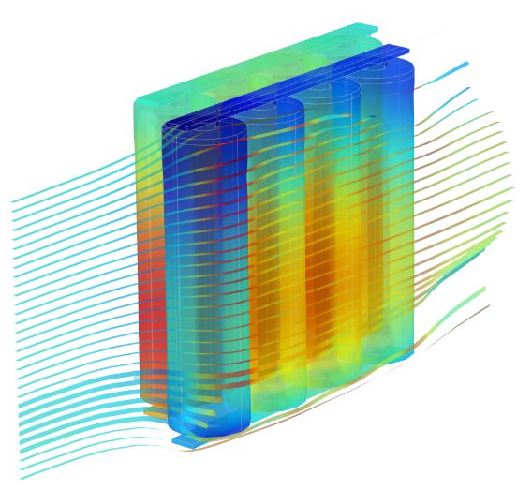
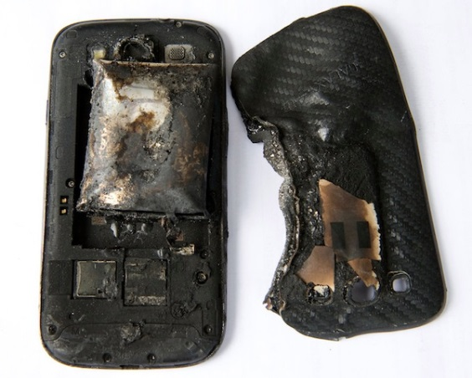
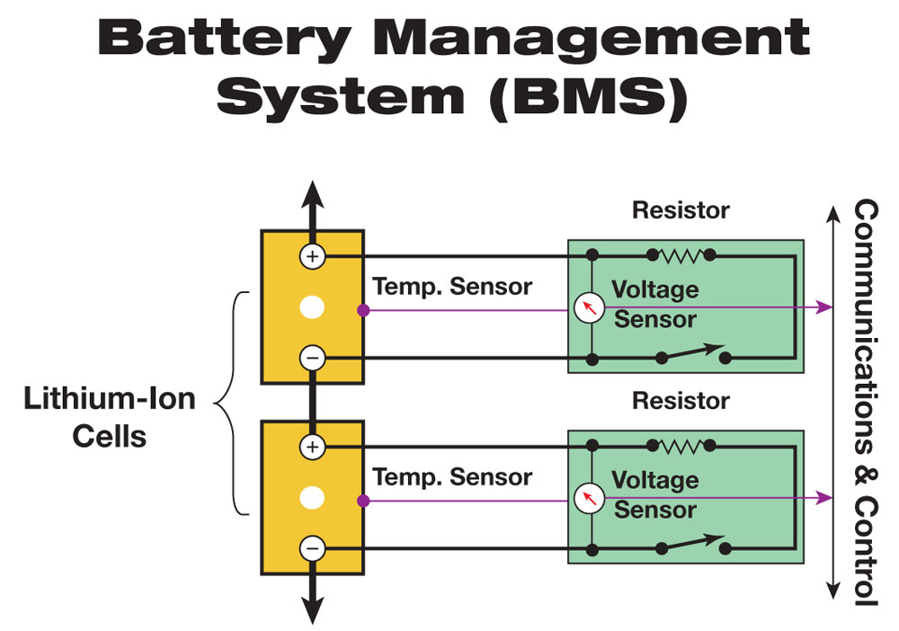
Motivation: Avoid of accidents with lithium ion batteries
→ overheating
→ overcharging
→ for development of BMS the
thermal behavior of the
battery must be known
COMSOL, www.techatplay.com
30.10.2013 E2C 2013 - 3rd European Energy Conference 03
Notes:
- LI-ion batteries consists of high energetic and reactive cathode and anode material, with a direct contact to a flammable electrolyte -> because of this safety must be guaranteed
- Depending on different operation conditions, like high temperature klick, mechanical stress klick or short circuit klick, you can see exothermic reactions in batteries
- Here are some examples what can happen if batteries overheat or were charged in the wrong way klick

Slide 4
Understanding batteries
Materials
(Constitution,
Synthesis,
Kinetics)
Crystal
chemistry, Microstructure,
Thermo-
dynamics
Electrochemical performance
and safety of
cells / batteries
Field of work
of the Accelerating
Rate Calorimeter
30.10.2013 E2C 2013 - 3rd European Energy Conference 03
Notes:
- Who wants to understand lithium ion batteries, must understand the correlations between materials properties, crystal chemistry as well as electrochemical performance and safety fundamentals of the battery
- The investigations of the thermodynamic properties and thereby the safety of the battery are klick the tasks of the accelerating rate calorimeter, short ARC – about this I want to talk today klick

Slide 5
Lithium ion batteries
discharging
charging
material of anode oxidized /
material of cathode reduced
material of anode reduced /
material of cathode oxidized
30.10.2013 E2C 2013 - 3rd European Energy Conference 05
Notes:
- First the set-up of a lithium ion battery
- For example: li-graphite-anode on a current collector consists of copper and on the other side the cathode material on a current collector consists of aluminum, and between for areal and electrical separation a separator impregnated with electrolyte
- discharge:
- material of anode oxidized → layer structure, li lies between carbon layers, li-atoms deliver one electron away and moves as li⁺-ion to the cathode
- material of cathode reduced → spinell structure, li⁺-ions lies in tubes
- In the discharge state the li⁺-ions stay ionized, because the electrons are absorbed by transitions metal ions
- charge:
- material of anode reduced → layer structure, electrons move in an react with the li⁺-ions form the cathode
- material of cathode oxidized → spinell structure, li⁺-ions lies in tubes
- During charge the elctrons moves away to the anode
- Here the fully redox reaction klick

Slide 6
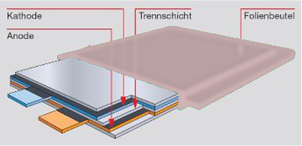
Lithium ion pouch cell
Anode material:
Li-graphite
Cathode material:
Li(Ni_{1/3}Mn_{1/3}Co_{1/3})O₂
Electrolyte
Separator
Pouch
30.10.2013 E2C 2013 - 3rd European Energy Conference 04
Notes:
- First the set-up of a lithium ion battery
- For example: li-graphite-anode on a current collector consists of copper and on the other side the cathode material on a current collector consists of aluminum, and between for areal and electrical separation a separator impregnated with electrolyte
- discharge:
- material of anode oxidized → layer structure, li lies between carbon layers, li-atoms deliver one electron away and moves as li⁺-ion to the cathode
- material of cathode reduced → spinell structure, li⁺-ions lies in tubes
- In the discharge state the li⁺-ions stay ionized, because the electrons are absorbed by transitions metal ions
- charge:
- material of anode reduced → layer structure, electrons move in an react with the li⁺-ions form the cathode
- material of cathode oxidized → spinell structure, li⁺-ions lies in tubes
- During charge the elctrons moves away to the anode
- Here the fully redox reaction klick

Slide 7
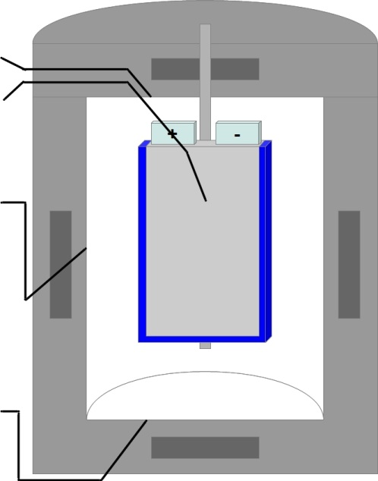
Principles of the Accelerating Rate Calorimeter (ARC)
ARC provides isoperibolic and adiabatic environments.
Under isoperibolic conditions the environmental temperature is constant.
Under adiabatic conditions the cell may be studied under conditions of minor heat loss.
EVARC: Ø: 25cm
h: 50cm
Top Temperature Sensor
Battery Temperature Sensor
Side Temperature Sensor
Bottom Temperature Sensor
30.10.2013 E2C 2013 - 3rd European Energy Conference 05
Notes:
- On this slide I show you my two adiabatic calorimeter, with which I analyze my batteries
- I have a small and a big one, in which I can do isothermal and adiabatic measurements
- My main samples this time are commercial pouch cells, here for example a 40Ah pouch cell, used for stationary energy storage and electro vehicles klick

Slide 8
Heat generation rate
$$Q=∆G+T∆S+ W_{el}$$
$${∆G=−nFE}_{eq}$$
$$∆S=nF\frac{dE_{eq}}{dT}$$
$$W_{el}=nFE$$
$${\dot{q}}_{T}=−I\left(E_{eq}−E\right)−IT\frac{dE_{eq}}{dT}+{\dot{q}}_{s}$$
Sources of heat generation rate:
The “reversible” heat dissipation caused
by the chemical reaction of the cell
The “irreversible” heat generation caused
by ohmic resistance and polarisation
The heat generation by “side reactions”,
i.e. parasitic/corrosion reactions and “chemical shorts”
$${\dot{q}}_{rev}=IT\frac{dE_{eq}}{dT}$$
$${\dot{q}}_{irrev}=I(E_{eq}−E)$$
$${\dot{q}}_{s}$$
S. Hallaj, H. Maleki, J.S. Hong, J.R. Selman, J. Power Source 83, p.1-8 (1999)
30.10.2013 E2C 2013 - 3rd European Energy Conference 06
Notes:
- The thermodynamic relations of the heat generation in a cell is given by the sum of gibbs free energy$∆G$, change of entropy $∆S$ and the electric work $W_{el}$
- With this the total heat generation rate results in the sum of reversible heat dissipation, caused by entropic change and the irreversible heat dissipation, caused by ohmic resistance and polarization as well as a part depending on parasitic reactions klick

Slide 9
Energy balance of our test set up
Energy balance for a lumped heat transfer system under natural convective heating conditions and a Biot number :
$$B_{i}≪0.1$$
$${m c}_{p}\frac{dT}{dt}=\dot{q}T− \text{a}\text{ARC} (T−T_{env}\text{) }$$
$${\dot{q}}_{T} {=\text{−}\text{a}\text{ARC} (T−T_{env}\text{) }+m c}_{p}\frac{dT}{dt}$$
Heat dissipation rate $\dot{q}d$
Enthalpy accumulation rate ${\dot{q}}_{e}$
Total heat generation:
$q_{T}$= $\text{a}\text{ARC}\int_{0}^{t}{ (T−T_{env}\text{)} dt}+{m c}_{p}$ $\left[T\left(t\right)−T\left(0\right)\right]$
D. Bernardi, E. Pawlikowski, J. Newman, J. Electrochem. Soc. 132, p.5-12 (1985)
30.10.2013 E2C 2013 - 3rd European Energy Conference 07
Notes:
- For a cell in an environment of uniform temperature obtains
- This shows that the total heat generation rate consists of the heat rate dissipated and enthalpy accumulation rate
- Integration over time gives the total heat generated by the battery klick

Slide 10
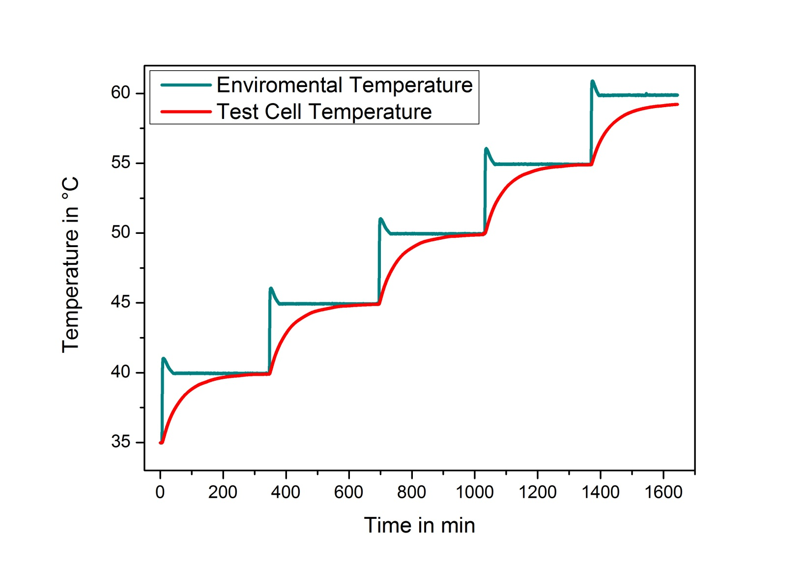
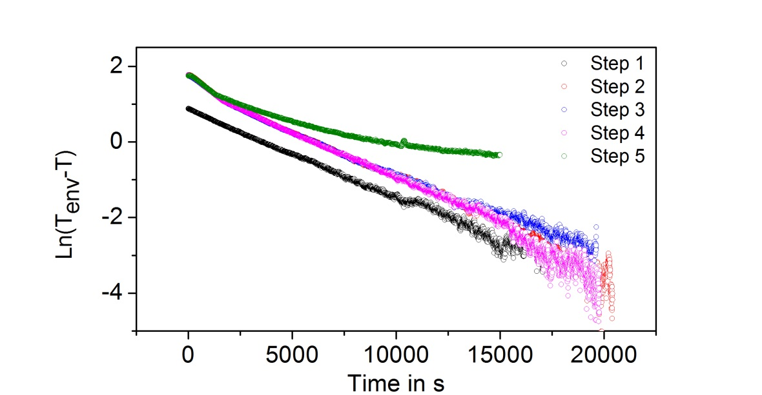
Parameter measurements: Calorimeter constant
$${\dot{q}}_{d}=\text{a}\text{ARC} (T−T_{env}\text{)}$$
α_{ARC} = (0.218 ± 0.003) W/K
Test Cell: rectangular block of AlMgSi1F30/EN AW-6082 T651
with same dimensions as pouch cell
30.10.2013 E2C 2013 - 3rd European Energy Conference 08
Notes:
- To get the total heat generated we have to find first the heat dissipation rate
- For this we need the so called calorimeter constant klick
- For this we use an aluminum test cell with the same dimensions like the battery and plotted the temperature behavior against time for a heating step by step
- The slope of the logarithm of T-T_{env} gives us the calorimeter constant in this example for the kokam cells. We have to do this for each cell type klick

Slide 11
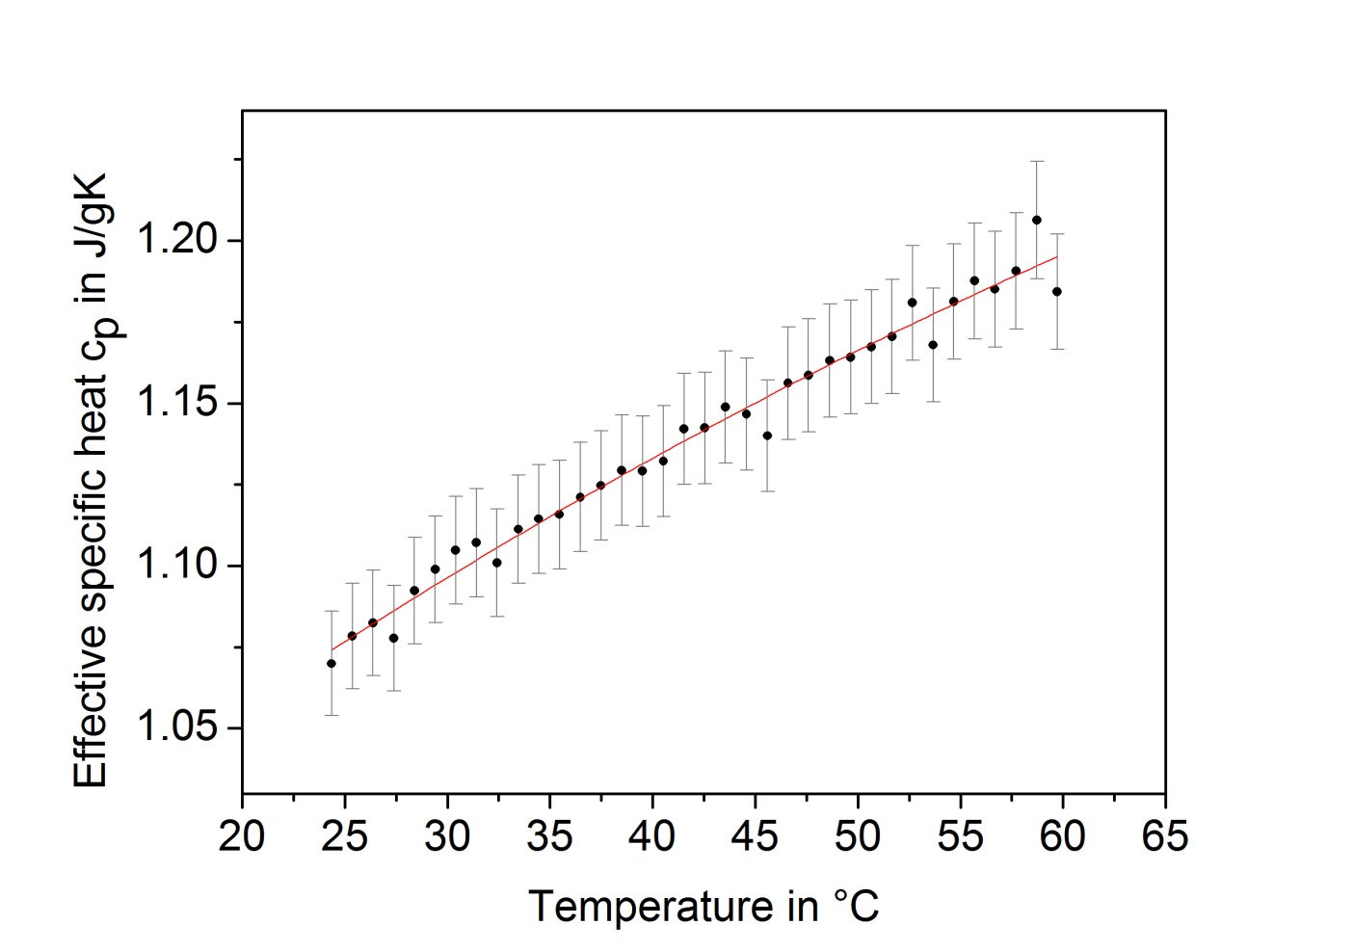
Parameter measurements: Effective specific heat capacity
$${\dot{q}}_{a}=m∙c_{p}\frac{dT}{dt}$$
$$c_{p}=1.10 J/{gK}$$
30.10.2013 E2C 2013 - 3rd European Energy Conference 09
Notes:
- The other part of the total heat generated is the enthalpy accumulation rate
- For this we need the specific heat klick
- In this case it’s an effective specific heat of the whole battery
- We investigated it depending on the state of charge with the heating method under adiabatic conditions klick

Slide 12
Isoperibolic measurements
Ideal conditions → single cell
temperature coefficient
$$\left(\frac{δE}{δT}\right)<0$$
discharge parameter:
method: constant current (CC)
U_{min} = 3.0V
I = 5A → C/8-rate
charge parameter:
method: constant current,
constant voltage (CCCV)
U_{max} = 4.1V
I = 5A → C/8-rate
I_{min} = 0.5A
at T_{env} = 30°C
H.-B. Ren, et. al., Int. J. Electrochem. Sci. 6, p. 727 – 738 (2011)
30.10.2013 E2C 2013 - 3rd European Energy Conference 10
Notes:
- Now we have all prefactor for analyzing the temperature behavoir of the battery
- We measured under two different conditions, here the first under ideal condition, a standalone battery, these are isoperibolic conditions, this means the environmental temperature is constant
- You can see the first four halfcycles of two c-rate depending measurements, cycling was between 3 and 4.1V, with a c-rate of C/8 (5A) and C/2 (20A)
- Because the temperature coefficient of li-ion batteries is negative, the cell warm up during discharging and cools down during charging. This you can see here. You can also see different parts in the half cycles, depending on different electrochemical processes klick

Slide 13
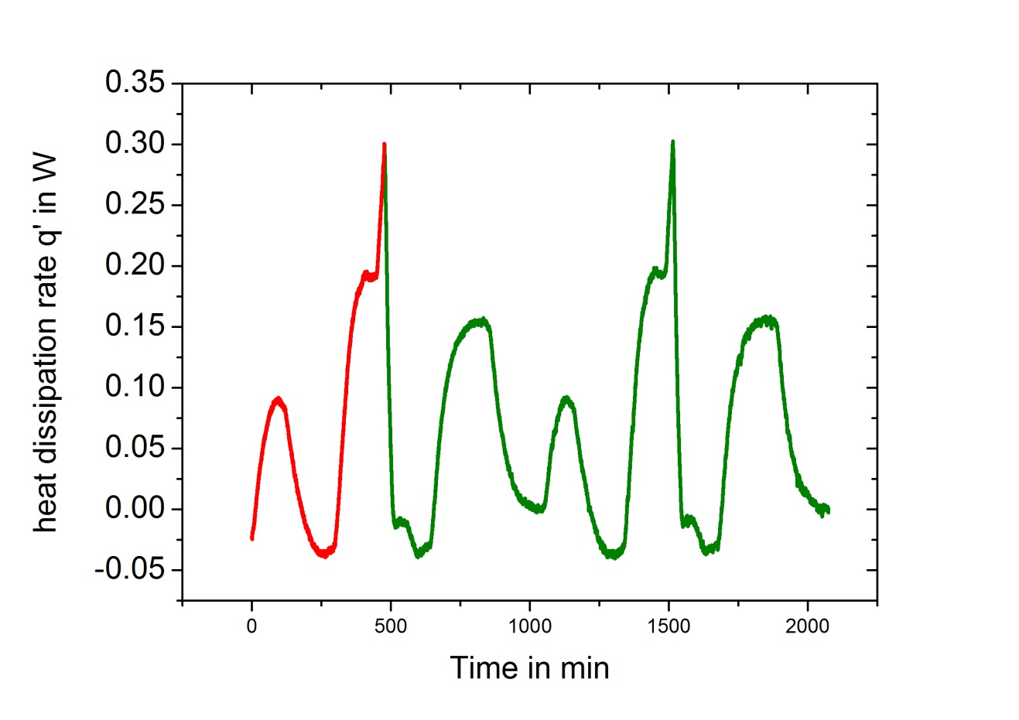
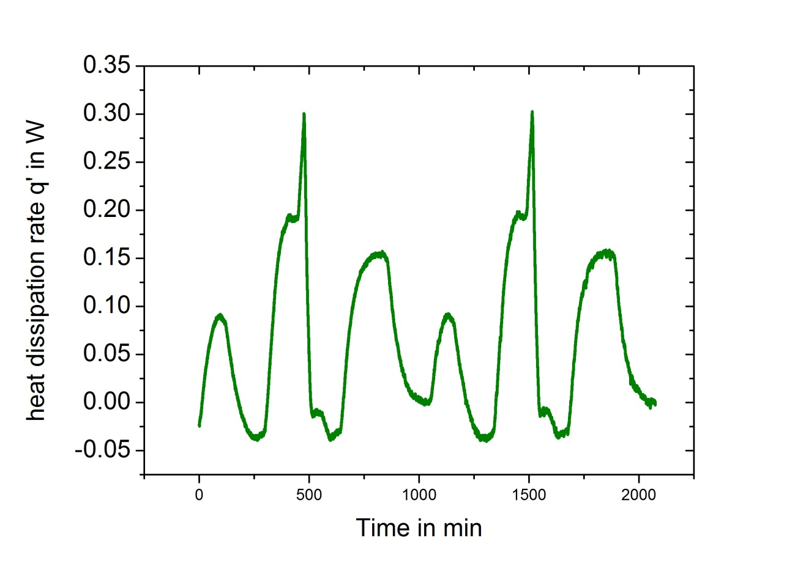
heat dissipation rate
$${\dot{q}}_{d}=\text{a}\text{ARC} (T−T_{env}\text{)}$$
α_{ARC} = (0.218 ± 0.003) W/K
Heat dissipated | $$q_{d}=1984J$$
effective specific heat at 40°C | $c_{p}$=$1.10J/{g∙K}$
mass of the cell | $$m=911.40g$$
Enthalpy accumulation heat | $$q_{e}=1445J$$
Total heat generation | $$q_{T}=3429J$$
30.10.2013 E2C 2013 - 3rd European Energy Conference 11
Notes:
- With the calorimeter constant we can calculate the heat dissipation rate klick
- And for example here for the first halfcycle, its discharge, the total heat generated by the battery klick

Slide 14
Adiabatic measurements
Worst case conditions → cell surrounded by other cells
temperature coefficient
$$\left(\frac{δE}{δT}\right)<0$$
discharge parameter:
method: constant current (CC)
U_{min} = 3,0V
I = 5A → C/8-rate
charge parameter:
method: constant current,
constant voltage (CCCV)
U_{max} = 4,1V
I = 5A → C/8-rate
I_{min} = 0.5A
Starting at room temperature
→ ΔT = 15.6K
30.10.2013 E2C 2013 - 3rd European Energy Conference 12
Notes:
- Now to the second conditions, the worst case conditions, a battery surrounded by other batteries, also heating in the same way
- These are adiabatic conditions, were no heat is lost out of the system
- The cycling parameters are the same like the isoperibolic measurements.
- In this case again the temperature coefficient is negative, so that the battery heat up during discharging and cools down during charging.
- But because of the adiabatic conditions the battery cannot cool down during charging although there are endothermic parts.
- So the battery heats up over all these cycles, here in this case at the C/8 rate 15K and at the C/2 rate 33K over four half cycles
- With longer cycling you can see that the charging parts become endothermic and the heating up becomes slower klick

Slide 15
Heat generation rate
$$Q=∆G+T∆S+ W_{el}$$
$${∆G=−nFE}_{eq}$$
$$∆S=nF\frac{dE_{eq}}{dT}$$
$$W_{el}=nFE$$
$${\dot{q}}_{T}=−I\left(E_{eq}−E\right)−IT\frac{dE_{eq}}{dT}+{\dot{q}}_{s}$$
Sources of heat generation rate:
The “reversible” heat dissipation caused
by the chemical reaction of the cell
The “irreversible” heat generation caused
by ohmic resistance and polarisation
The heat generation by “side reactions”,
i.e. parasitic/corrosion reactions and “chemical shorts”
$${\dot{q}}_{rev}=IT\frac{dE_{eq}}{dT}$$
$${\dot{q}}_{irrev}=I(E_{eq}−E)$$
$${\dot{q}}_{s}$$
S. Hallaj, H. Maleki, J.S. Hong, J.R. Selman, J. Power Source 83, p.1-8 (1999)
30.10.2013 E2C 2013 - 3rd European Energy Conference 13
Notes:
- The thermodynamic relations of the heat generation in a cell is given by the sum of gibbs free energy$∆G$, change of entropy $∆S$ and the electric work $W_{el}$
- With this the total heat generation rate results in the sum of reversible heat dissipation, caused by entropic change and the irreversible heat dissipation, caused by ohmic resistance and polarization as well as a part depending on parasitic reactions klick

Slide 16
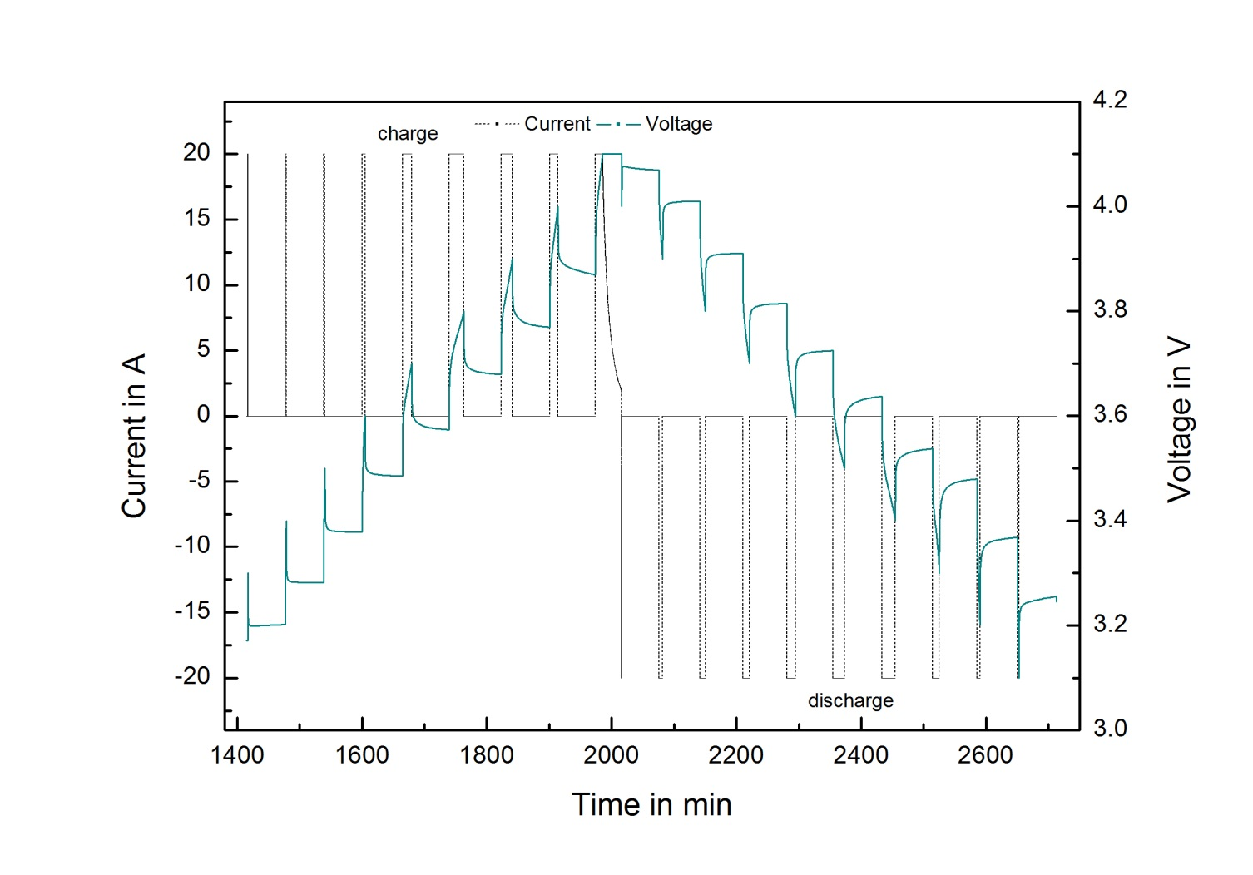
Determination of irreversible heat:
DC current interrupted technique
Irreversible heat rate:
$${\dot{q}}_{irrev}=−I^{2}R_{i}$$
ΔV_{i} instantaneous voltage drop
due to ohmic resistance and
partially polarization
$$R_{i}={∆V_{i}}/I$$
$${\dot{q}}_{irrev}=1.4W$$
$$R_{rel}={∆V_{rel}}/I$$
ΔV_{rel} relaxation voltage drop due
to the polarization
30.10.2013 E2C 2013 - 3rd European Energy Conference 13
Notes:
- Remember some slides before the total heat generation rate consists of two parts, the reversible and the irreversible part. It’s important to minimize the irreversible part but to can do this it’s first important to know this part klick
- For this we investigate the batteries with the DC current interrupted technique
- With this we measure the cell overvoltage at different depth of discharge. The discharge current was I=20A and after current interrupted the cell was left to relax for 60min.
- Instantanenous voltage drop, due to ohmic resistance and partially concentration polarization could be measured immediately and the relaxation voltage drop due to the concentration polarization was measured over the interrupted period klick
- During charge the instantaneous resistance decrease and during discharge it’s nearly the same with a small increasing at the end klick

Slide 17
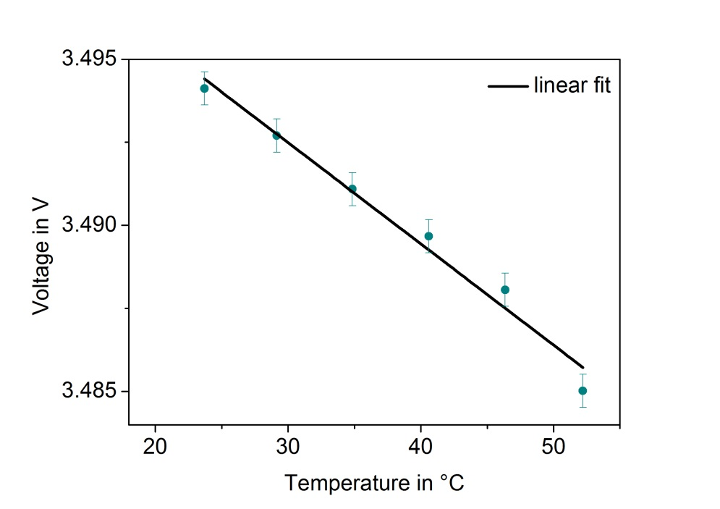
Determination of reversible heat:
Potentiometric measurements
$${\dot{q}}_{rev}=IT\frac{dE_{eq}}{dT}$$
Reversible heat rate:
@ 3.49V
$$→\frac{dE_{eq}}{dT}=−3.05∙{10}^{−4}V/K$$
$${→ \dot{q}}_{rev}=0.46 W$$
30.10.2013 E2C 2013 - 3rd European Energy Conference 14
Notes:
- To confirm the negative temperature coefficient of cell and quantify the reversible heat, the entropy change was determined by direct measurement of the equilibrium cell voltage as a function of time klick
- Here for example for the enertech cell klick

Slide 18
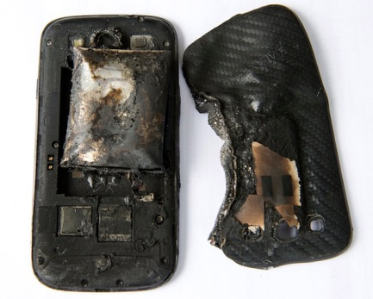
Conclusions
Different temperature behavior under isoperibolic/adiabatic conditions,
→ under isoperibolic conditions the cell can cool down independently
→ under adiabatic conditions the cell heats up
→ significant temperature rise even for
low charge/discharge rates
The thermal behavior under normal condition now are known
→ BMS can be improved
Separation of reversible and irreversible heat effects possible
→ next step: reducing the influences of the irreversible heat
30.10.2013 E2C 2013 - 3rd European Energy Conference 15
Notes:
- Different temperature behavior under isoperibolic/adiabatic conditions,
→ under isoperibolic conditions the battery can cool down indepently
→ under adiabatic conditions the battery heat up
- Temperature increase rises with rising C-rate
- At adiabatic conditions significant temperature rise even for low charge/discharge rates
- Separation of reversible and irreversible heat effects possible klick

Slide 19
Thank you
for your attention!
We gratefully acknowledge the funding by the German Research Foundation priority programme SPP1473 WeNDeLIB
30.10.2013 E2C 2013 - 3rd European Energy Conference 16
Notes:
- I will gratefully acknowledge the German Research Foundation priority programme SPP1473 WeNDeLIB
- Thank you for your attention
- Are there any questions?

Slide 20
Cell Specifications
Parameter |  | Manufacturer A | Manufacturer B
Typical Capacity in Ah [@ 0.5 C, 25 °C] |  | 40 [@0.2 C] | 40 [@0.5 C, 25 °C]
Nominal Voltage in V |  | 3.7 | 3.7
Gravimetric Energy Density in Wh/kg |  | 156 | -
Volumetric Energy Density in Wh/l |  | 323 | -
Charge Condition | Max. Current in A | 40 | 80
 | Max. Voltage in V | 4.2 | 4.2 ± 0.03
Discharge Condition | Continuous Current in A | 160 | 200
 | Peak Current in A | - | 400
 | Cut-Off Voltage in V | 3.0 | 2.7
Cycle Life [@ 80% DOD] |  | - | > 800 cycles
AC Impedance (@ 1 kHz) |  | 3 mΩ or less | -
Operating Temperature in °C | Charge | 0 ~ 40 | 0 ~ 40
 | Discharge | -20 ~ 55 | -20 ~ 60
Dimension | Thickness in mm | 9.8 ± 0.5 | 10.7 ± 0.5
 | Width in mm | 187 ± 2.0 | 215 ± 2.0
 | Length in mm | 250 ± 2.0 | 220 ± 2.0
Weight in g |  | 950 or less | 1,100 ± 40
30.10.2013 E2C 2013 - 3rd European Energy Conference 16

